Slide 1
Digital Circuits and Systems Lecture 7 Pipeline and Parallel
Tian Sheuan Chang
想要變得更快，要怎麼做呢?

Slide 2
Outline [Dally. Ch. 23]
如何設計一個系統
讓設計變快一點
改變計算方法/演算法 (not covered in this course)
增加一點平行度 (pipeline or duplicate unit)
Notes:
舉例: image scaling *
One multiplier
Higher processing rate
Two multiplier, or pipeline

Slide 3
如何設計一個系統 System Design – a process
Specification 規格先搞清楚
Understand what you need to build
Divide and conquer 把大問題切成幾個小的，容易做也容易分工
Break it down into manageable pieces
Define interfaces 界面第一，定義好有哪些輸出入訊號
Clearly specify every signal between pieces
Hide implementation
Choose representations
Timing and sequencing 界面訊號的timing
Overall timing – use a table
Timing of each interface – use a simple convention (e.g., valid – ready)
Add parallelism as needed (pipeline or duplicate units) 根據速度需求，選擇平行多套或pipeline
Timing and sequencing (of parallel structures)
Design each module 設計個別模組
Code
Verify
Iterate back to the top at any step as needed.

Slide 4
Performance of Combinational Circuits
For combinational logic: L = t_{PD}, (latency)
F
T = 1/t_{PD} (throughput).
X
H
P(X)
We can’t get the answer faster, but are we making effective use of our hardware at all times?
G
讓硬體利用率提高
X F(X)
G(X)
P(X)
F & G are “idle”, just holding their outputs stable while H performs its computation
Notes:
http://web.mit.edu/6.111/www/f2016/handouts/L09.pdf

Slide 5
Retiming Combinational Circuits aka “Pipelining”
15
15
X
25
P(X)
X_{i}
25
P(X_{i-2})
20
20
Assuming ideal registers: i.e., t_{PD} = 0, t_{SETUP} = 0
t_{CLK} = 25
L = 2*t_{CLK} = 50 T = 1/t_{CLK} = 1/25
L = 45
T = 1/45
Notes:
http://web.mit.edu/6.111/www/f2016/handouts/L09.pdf

Slide 6







Retiming (Optional) (Theory behind pipeline)
Retiming is the action of moving registers around in the system
Registers have to be moved from ALL inputs to ALL outputs or vice versa
Cutset retiming: A cutset intersects the edges, such that this would result in two disjoint partitions of the edges being cut. To retime, delays are moved from the ingoing to the outgoing edges or vice versa.
Benefits of retiming:
Modify critical path delay
Reduce total number of registers
Notes:
Retiming
• Generalization of Pipelining
• Pipelining is Equivalent to Introducing
Many delays at the Input followed by
Retiming
http://web.mit.edu/6.111/www/f2016/handouts/L09.pdf

Slide 7
Pipeline diagrams
F
15
Clock cycle
X
H
25
P(X)
G
i
i+1
i+2
i+3
20
Input | X_{i} | ^{X}i+1 | ^{X}i+2 | ^{X}i+3 | …
F Reg G Reg |  | F(X_{i}) G(X_{i}) | F(X_{i+1}) G(X_{i+1}) | F(X_{i+2}) G(X_{i+2}) | …
H Reg |  |  | H(X_{i}) | H(X_{i+1}) | H(X_{i+2})
Pipeline stages
The results associated with a particular set of input data moves diagonally through the diagram, progressing through one pipeline stage each clock cycle.
Notes:
http://web.mit.edu/6.111/www/f2016/handouts/L09.pdf

Slide 8
Pipeline Conventions
DEFINITION:
a K-Stage Pipeline (“K-pipeline”) is an acyclic circuit having exactly K registers on every path from an input to an output.
a COMBINATIONAL CIRCUIT is thus an 0-stage pipeline.
CONVENTION:
Every pipeline stage, hence every K-Stage pipeline, has a register on its OUTPUT (not on its input).
ALWAYS:
The CLOCK common to all registers must have a period sufficient to cover propagation over combinational paths PLUS (input) register t_{PD} PLUS (output) register t_{SETUP}.
The LATENCY of a K-pipeline is K times the period of the clock common to all registers.
The THROUGHPUT of a K-pipeline is the frequency of the clock.
Notes:
http://web.mit.edu/6.111/www/f2016/handouts/L09.pdf

Slide 9
Ill-formed pipelines
Consider a BAD job of pipelining:
A
1
2
X
C
B
Y
For what value of K is the following circuit a K-Pipeline? none Problem:
Successive inputs get mixed: e.g., B(A(X_{i+1}), Y_{i}). This happened because some paths from inputs to outputs have 2 registers, and some have only 1!
This CAN’T HAPPEN on a well-formed K pipeline!

Slide 10
Pipeline Example
2
3
1
OBSERVATIONS:
1-pipeline improves neither L or T.
T improved by breaking long combinational paths, allowing faster clock.
Too many stages cost L, don’t improve T.
Back-to-back registers are often required to keep pipeline well- formed.
X
A
C
2
1
2
3
Y
B
1
 | LATENCY | THROUGHPU
0-pipe: | 4 | 1/4
1-pipe: | 4 | 1/4
2-pipe: | 4 | 1/2
3-pipe: | 6 | 1/2
T
Notes:
http://people.ece.umn.edu/users/parhi/SLIDES/chap4.pdf
1-pipe throughput 每四個cycle 一筆資料
3-pipe latency = 2 +２＋２＝ ６ （每個stage 都是2)
0810864

Slide 11


Pipeline Example - Verilog
pixel
G = game logic 8ns tpd
C = draw round puck, use multiply with 9ns tpd
System clock 65mhz = 15ns period – opps
G
8
C
9
X
Y
intermediate wires
hcount, vcount, etc
No pipeline
reg [N:0] x,y; reg [23:0] pixel always @ * begin
y=G(x);
pixel = C(y);
assign y = G(x);
// logic for y
// logic for pixel
assign pixel = C(y)
pixel_w
end
G
8
Y Y2
C
9
pixel
分開comb, seq logic
X
always @ * begin
y=G(x);
pixel_w = C(y);
end
always @(posedge clock)begin
y2 <= y; // pipeline y
pixel <= pixel_w; // pipeline pixel
end
clock
clock
Pipeline
always @(posedge clock)
...
Latency = 2 clock cyles! Implications?
begin
y2 <= G(x);
pixel <= C(y2)
// pipeline y
// pipeline pixel
end

Slide 12
Design Case Study

Slide 13
Two Design Case
Unconstrainted 沒限制，
追求最高速度 (工作頻率 或throughput)
最小面積
Constrained
滿足一定處理速度要求下，面積或power 最小

Slide 14
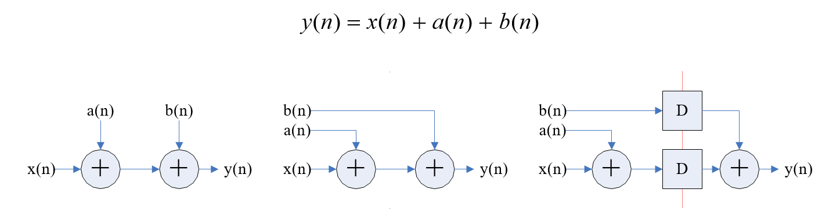
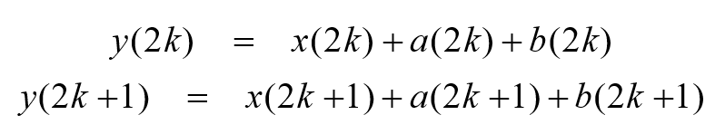
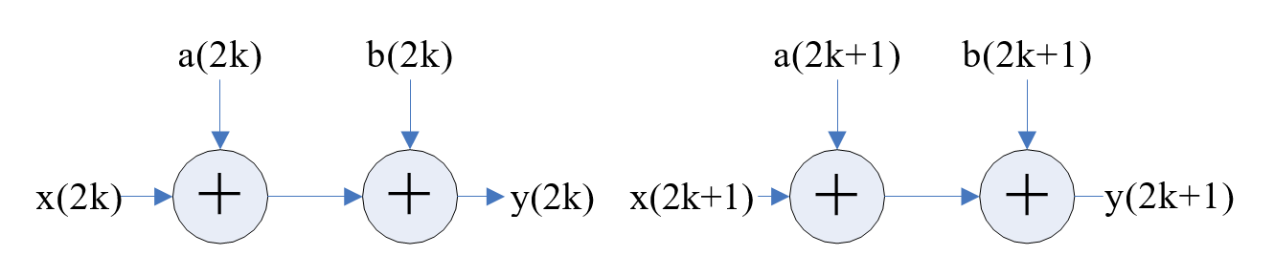
A Simple Design
Pipeline
Parallel
2x throughput
Delay = 2 T_{adder}
Delay = 1 T_{adder}
Notes:
對圖一 a’)進行並行擴展也非常簡單，注意觀察反覆運算式子或者圖一 a)，節點不存在反覆運算間的優先關係，也就是說任一次反覆運算都可以單獨進行而與其他次反覆運算沒依賴關係。比如想構造一個 2 階並行處理系統，那麼可以將輸入序列 x(n)、a(n)和 b(n)分為奇偶兩列分別由兩套相同的硬體電路來算。具體做法是，將 n=2k 和 n=2k+1 帶入原反覆運算式，得兩個新的反覆運算式

Slide 15
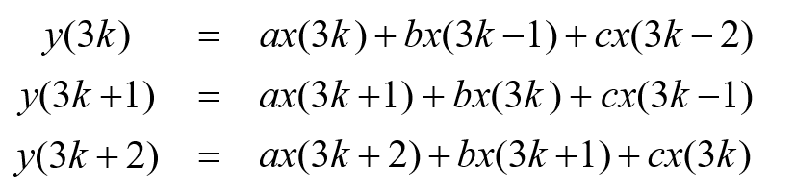

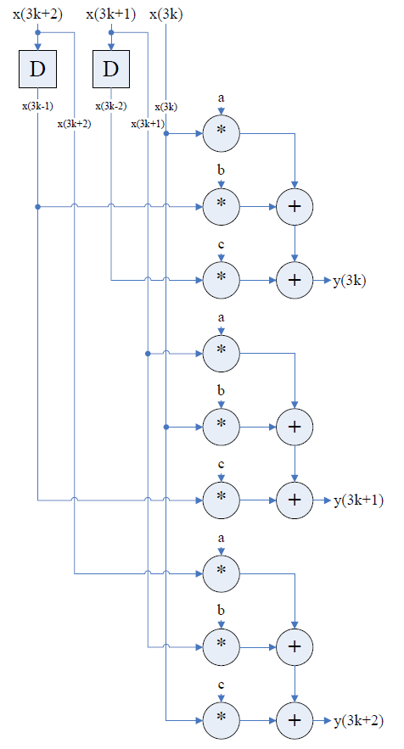
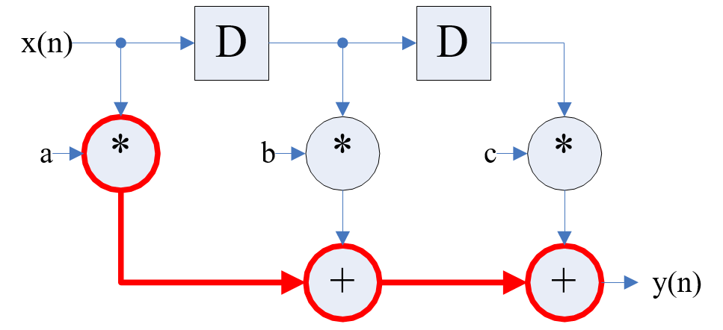
3-Taps FIR Filter
3X parallel
(share DFFs)
直接實現
Critical path

Slide 16
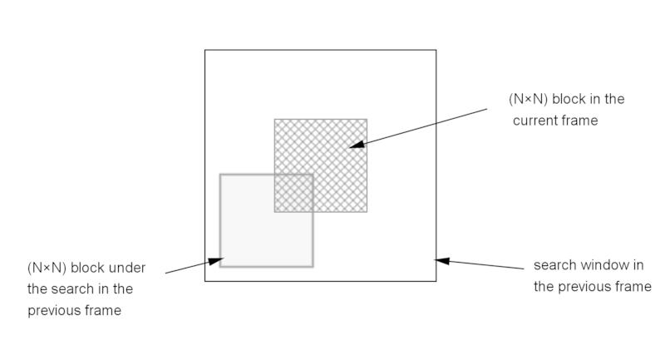
Motion Estimation
System analysis
Processing number of LCU per frame
Assume frame size 4096x2048
Frame_Size / LCU_Size
= (4096*2048) / (64*64) = 2048 LCUs
The available cycles per LCU
Assume 30 frames per second
Frequency / LCU_Number
= 270 MHz / (2048*30) = 4395 cycles

Slide 17
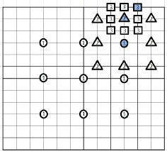
LCU operations
64x64 SAD (sum of absolute difference) per search point
16x16 search points
Operations = 16x16x64x64=1048576 SAD
Parallelism
1048576/4395 = 238 SADs per cycle
=> 16x16 SAD unit
Near minimum area cost
Can we reduce area cost further?
Fewer search points => fast algorithm, e.g. 3-step search (3x9 = 27 points)

Slide 18
Pipeline and parallel

Slide 19
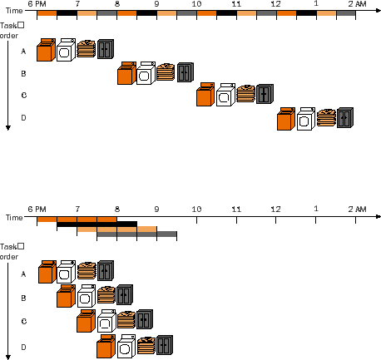
變快的兩招: 平行多套 或與 pipeline
原來執行方式
一個資料全部執行完，
才換下一個資料
Q. 缺點
Parallel
使用多套硬體，
同時處理多個資料
輸出變快
Q. Parallel 極限在哪裡
Notes:
開洗衣店，洗烘折收，各花0.5小時
四個人要洗
共花 0.5*4*4

Slide 20
變快的兩招: 平行多套 或與 pipeline
原來執行方式
一個資料全部執行完，
才換下一個資料
Pipeline
分成多級，執行完一級，
下一個資料就可以進行處理
把一級所需時間
切得更細更少，頻率變快
輸出變快
Q. Pipeline 極限在哪裡

Slide 21
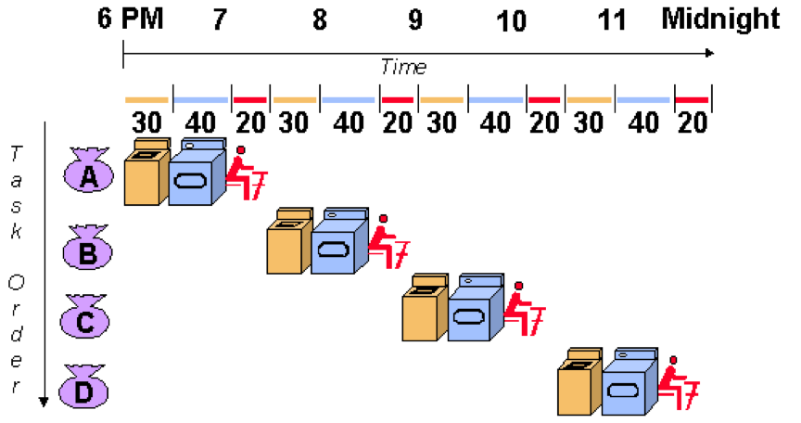
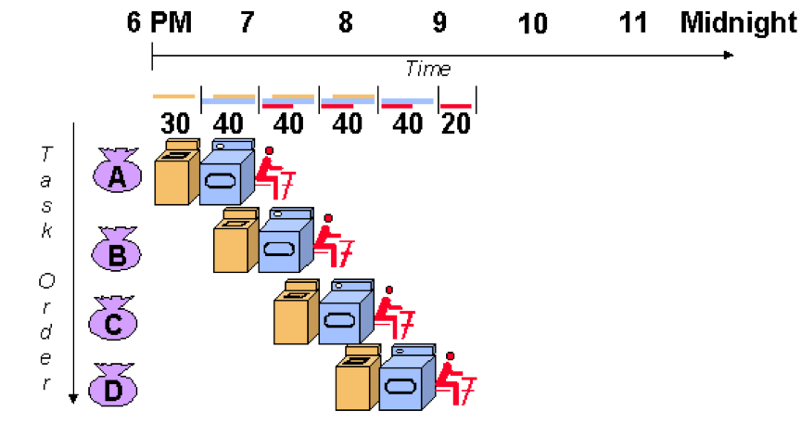
各級速度不一樣
會被最慢的哪一級限制住速度

Slide 22
pipeline and parallel 適合用在哪?
//for computation-oriented, e.g. Z=Σ|X_{i}-Y_{i}|
in motion/pattern detection
計算類比較規則，適合pipeline
Or parallel
//for control-oriented, e.g. if or while
Statement in decision making
控制類較不規則，pipeline
容易空轉，適合parallel

Slide 23
Pipeline a 32-bit ripple carry adder
Like an assembly line – each pipeline stage does part of the work and passes the ‘workpiece’ to the next stage
Example 1: Pipelined 32b Adder
Exercise: What is the critical
Path and area of this 32-bit
Ripple adder?
Assume one-bit full adder (FA)
Has the following:
Delay: T_{1bFA}
Area: A_{1bFA}

Slide 24
Split into 4 8-bit adders
Note: the purpose of exploiting
Pipelining is to speed up circuit
Performance. As a result, each 8-bit
Adder can be improved
By those carry propagation
Reduction methods mentioned
Earlier.
For example, carry-look-ahead
(CLA) with carry-select-adder (CSA)
Can be combined to speed up carry
Propagation.

Slide 25
Split into stages 4 problems ‘in process’ at once
Exercise: what is the clock rate for this pipelined adder?
How many extra areas are demanded to realize this adder?

Slide 26
Pipeline Diagram Illustrates pipeline timing
Latency depends on the
Number of pipelining stages.
Latency: outputs are available after the lateny.

Slide 27
Movie Illustration of Pipelined Adder

Slide 28
Cycle 1

Slide 29
Cycle 2

Slide 30
Cycle 3

Slide 31
Cycle 3
clock
3
3

Slide 32

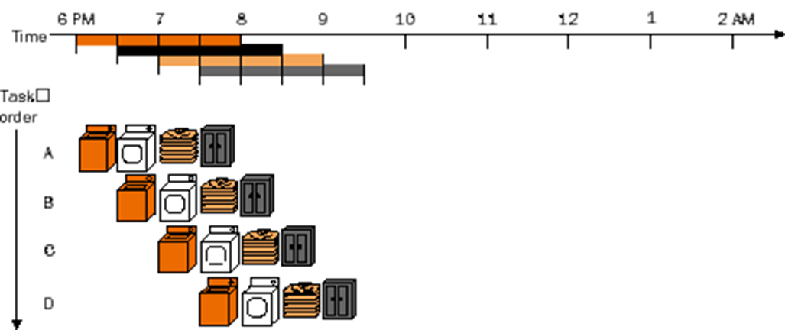
Pipeline可以跑多快: Latency and throughput
Latency != delay
1 add per 10 ns => latency = 10ns
Pipeline 從第一級執行到最後一級所花的時間
Latency = Σ(一級組合邏輯時間+pipeline overhead)
Pipeline overhead = register (DFF)所需要的時間
Pipeline 不會加快單一工作的latency
Throughput(Pipeline會增加throughput)
單位時間內可以處理完的工作
1 add per 10ns => 100MOPs
Throughput = 1/(pipeline 的工作頻率)
Pipeline的工作頻率 =
1/(最長那一級組合邏輯時間+pipeline overhead)

Slide 33
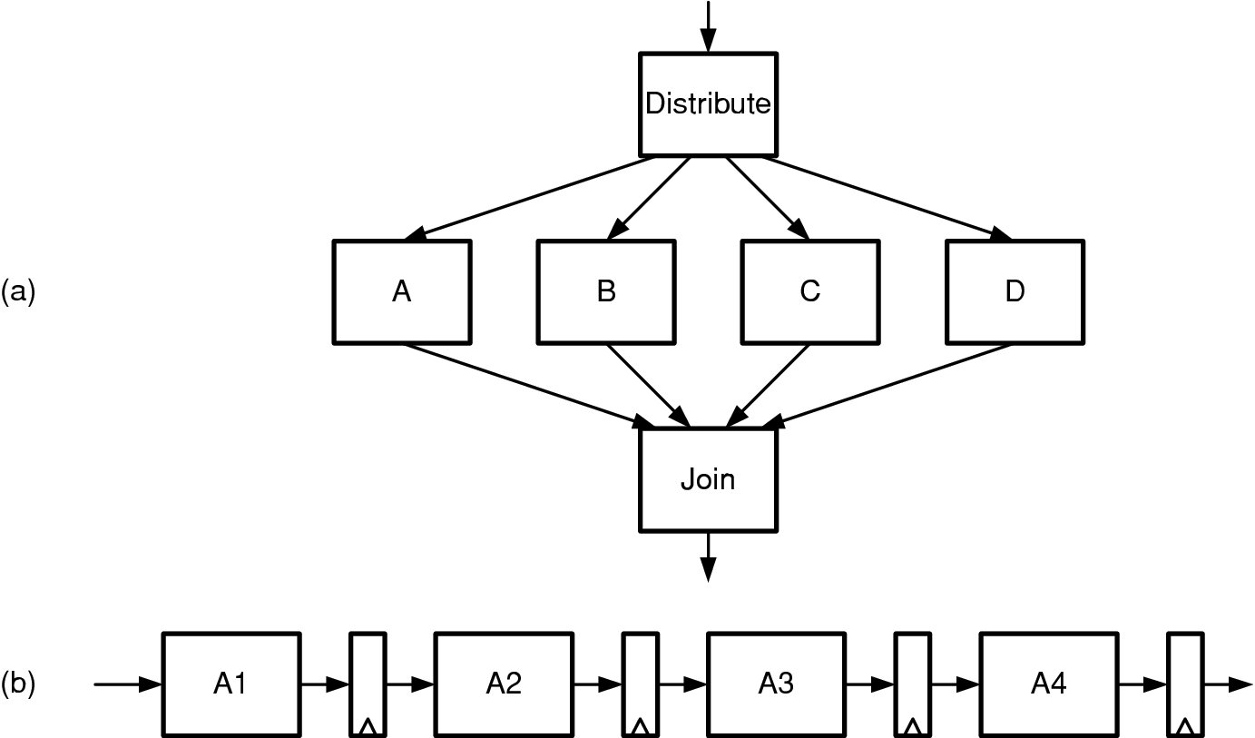
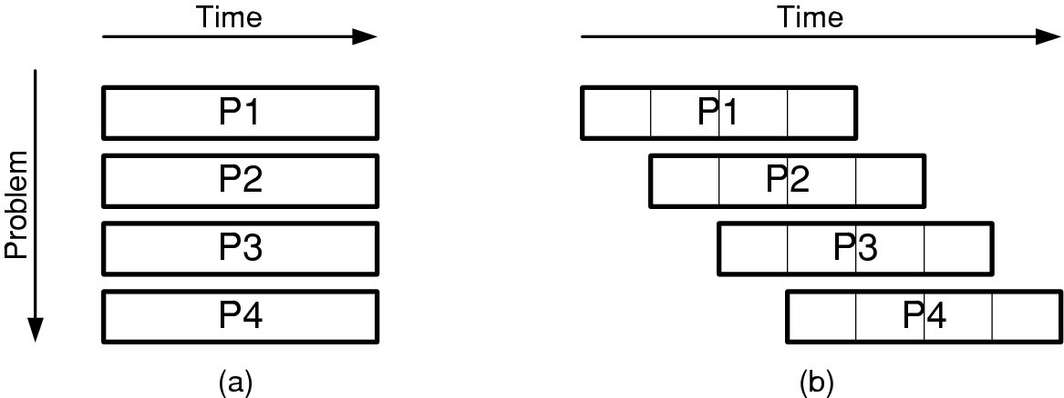
Example 算算可以跑多快
Increase throughput of a module with delay T = 10ns by x4
Parallel:
four copies. T= 10ns, but with 4 output (400MOPs)
With register overhead (0.2ns),
latency = 10+0.2=10.2ns, throughput=4/10.2=392MOPs
pipeline:
Four stages, each stage delay =10/4=2.5
Ideally, (without register overhead)
One output per 2.5ns
=> 10ns => 4 output =>4 times throughput
With Pipeline overhead (0.2ns)
Latency 10+ 0.2*4 = 10.8ns
Throughput 1/(2.5+0.2) = 370MOPs
Vote: choose parallel or pipeline
Notes:
Vote. 1. choose parallel or pipeline

Slide 34
Example: Pipeline a Ripple Carry Adder 算算可以跑多快
Suppose before pipelining, the delay of our 32b adder is 3200ps (100ps per bit) and this adder can do one problem each 3200ps for a throughput of 1/3200ps = 312Mops
What is the delay (latency) and throughput of the adder with pipelining? Suppose t_{dCQ} = 100ps, t_{s} = 50ps, t_{k} = 50ps (200ps Overhead)
t_{pipe} = n(t_{stage} + t_{dCQ} + t_{s} + t_{k}) // with register overhead
Θ = n/t_{pipe} = 1/(t_{stage} + t_{dCQ} + t_{s} + t_{k}) //throughput 4/
t_{stage}= 3200/4=800ps
t_{dCQ} + t_{s} + t_{k} = 100+50+50=200ps
t_{pipe} = 4(800+200) =4000ps
Θ = 4/4000ps = 1 GOPs

Slide 35
More examples

Slide 36
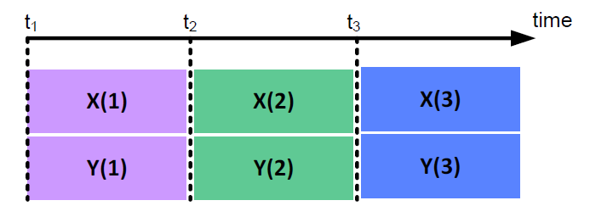
Architectural Techniques : Pipeline depth
Pipeline depth: 0 (No Pipeline)
Critical path: 3 Adders
Latency : 0
a(n) b(n)
c(n)
wire w1, w2; assign w1 = X + a; assign w2 = w1 + b; assign Y = w2 + c;
w1
w2
X(n)
Y(n)

Slide 37
Architectural Techniques : Pipeline depth
Pipeline depth: 1 (One Pipeline register Added)
Critical path: 2 Adders
Latency : 1
wire w1; reg w2;
assign w1 = X + a; assign Y = w2 + c;
always @(posedge Clk) w2 <= w1 + b;
a(n)
b(n)
c(n)
w1
w2
X(n)
Y(n)
t₁
t₂
t₃
t₄
time
 |  |  | Y(3)
X(1) | X(2) | X(3)
 | Y(1) | Y(2)

Slide 38
Architectural Techniques : Pipeline depth
Pipeline depth: 2 (One Pipeline register Added)
Critical path: 1 Adder
Latency : 2
reg w1, w2;
assign Y = w2 + c;
always @(posedge Clk) begin
w1 <= X + a;
w2 <= w1 + b;
end
a(n) b(n) c(n)
w1 w2
X(n)
Y(n)
t₁ t₂
t₃
t₄
t₅
X(1)
X(2)
X(3)
Y(1)
Y(2)
Y(3)

Slide 39
Architectural Techniques : Fine-Grain Pipelining
Pipelining at the operation level
Break the multiplier into two parts
X(n)
X(n-1)
X(n-2)
X(n)
X(n-1)
X(n-2)
Fine-Grain
Pipelining
a
b
c
m1
m1
m1
a
b
c
Y(n)
m2
m2
m2
Y(n) = ax(n) + bx(n-1) + cx(n-2)
Y(n)

Slide 40
Unrolling the Loop Using Pipelining
module power3( output reg [7:0] X3, output finished, input [7:0] X,
input clk, start); reg [7:0] ncount;
reg [7:0] Xpower, Xin;
assign finished = (ncount == 0); always@(posedge clk)
if (start) begin XPower <= X; Xin<=X; ncount <= 2;
X3 <= XPower;
end
else if(!finished) begin ncount <= ncount - 1; XPower <= XPower * Xin;
End
endmodule
Calculation of X3
Throughput = 8/3, or 2.7 bits/clock
Latency = 3 clocks
Timing = One multiplier in the critical path
Iterative implementation:
No new computations can begin until the previous computation has completed
0
X[0:7]
1
xpower
start
Clk

Slide 41

Unrolling the Loop Using Pipelining
module power3(
output reg [7:0] XPower, input clk,
input [7:0] X);
reg [7:0] XPower1, XPower2;
reg [7:0] X2;
always @(posedge clk) begin
// Pipeline stage 1 XPower1 <= X;
// Pipeline stage 2
XPower2 <= XPower1 * XPower1 ; X2 <= XPower1 ;
// Pipeline stage 3 XPower <= XPower2 * X2; end
endmodule
Calculation of X3
Throughput = 8/1, or 8 bits/clock (3X improvement)
Latency = 3 clocks
Timing = One multiplier in the critical path
Penalty: More Area
Unrolling an algorithm with n iterative loops increases
throughput by a factor of n
X2
Clk
X[0:7]
xpower
xpower1
xpower2
Clk

Slide 42
Removing Pipeline Registers (to Improve Latency)
Calculation of X3
Throughput = 8 bits/clock (3X improvement)
Latency = 0 clocks
Timing = Two multipliers in the critical path
module power3(
Output [7:0] XPower,
input [7:0] X);
reg [7:0] XPower1, XPower2; reg [7:0] X1, X2;
always @(*)
XPower1 = X; always @(*) begin
X2 = XPower1;
XPower2 = XPower1*XPower1; end
assign XPower = XPower2 * X2; endmodule
Latency can be reduced by removing pipeline registers
X2
X[0:7]
xpower
xpower1
xpower2

Slide 43
Architectural Techniques : Parallel Processing
In parallel processing the same hardware is duplicated to
Increases the throughput without changing the critical path
Increases the silicon area
a(n) b(n)
Clock Freq: f Throughput: M samples
X(n)
Y(n)
Pipelining
Parallel Processing
a(2k)
b(2k)
a(n)
b(n)
X(2k)
Y(2k)
X(n)
Y(n)
a(2k+1)
b(2k+1)
Clock Freq: 2f Throughput: 2M samples
X(2k+1)
Y(2k+1)
Clock Freq: f Throughput: 2M samples

Slide 44


















Architectural Techniques : Parallel Processing
Parallel processing for a 3-tap FIR filter
Both have the same critical path (M+2A)
X(3k+2)
X(3k+1)
X(3k)
a
b
c
X(n)
X(n-1)
X(n-2)
Y(3k+2)
a
b
c
X(3k-2)
X(3k-1)
Parallel Factor:3
Y(n)
c
a
b
Y(3k+1)
b
c
a
Y(3k)

Slide 45


Register Balancing (to Improve Timing)
Redistribute logic evenly between registers to minimize the worst-case delay between any two registers
b/c clock is limited by only the worst-case delay
module adder( output reg [7:0] Sum, input [7:0] A, B, C, input clk);
reg [7:0] rA, rB, rC;
always @(posedge clk) begin rA <= A;
rB <= B; rC <= C;
Sum <= rA + rB + rC; end
endmodule
A
rA
Clk
B
rB
Sum
Clk
C
rC
Clk

Slide 46


Register Balancing (to Improve Timing)
Redistribute logic evenly between registers to minimize the worst-case delay between any two registers
b/c clock is limited by only the worst-case delay
module adder( output reg [7:0] Sum, input [7:0] A, B, C, input clk);
reg [7:0] rABSum, rC;
always @(posedge clk) begin rABSum <= A + B;
rC <= C;
Sum <= rABSum + rC; end
endmodule
A
rABSum
B
Clk
C
rC
Sum
Clk

Slide 47
Speed-related Techniques: Summary
Throughput-related:
A high-throughput architecture is one that maximizes the number of bits per second that can be processed by a design.
Unrolling an iterative loop increases throughput.
The penalty for unrolling an iterative loop is an increase in area.
Latency-related:
A low-latency architecture is one that minimizes the delay from the input of a module to the output.
Latency can be reduced by removing pipeline registers.
The penalty for removing pipeline registers is an increase in combinatorial delay between registers.

Slide 48
Speed-related Techniques: Summary
Timing-related:
Timing refers to the clock speed of a design. A design meets timing when the maximum delay between any two sequential elements is smaller than the minimum clock period.
Adding register layers improves timing by dividing the critical path into two paths of smaller delay.
Separating a logic function into a number of smaller functions that can be evaluated in parallel reduces the delay to the longest of the substructures.
By removing priority encodings where they are not needed, the logic structure is flattened, and the path delay is reduced.
Register balancing improves timing by moving combinatorial logic from the critical path to an adjacent path.

Slide 49
Simple and complex pipeline

Slide 50
Example 2: Processor Pipeline
RISC machine based on
Harvard architecture,
Also known as
Load-Store machine
Notes:
Add r0, r1, r2 //r0 = r1+r2

Slide 51
Example 3: Graphics rendering pipeline
Graphic processor, dominated by Nvidia
Large amounts of Graphic processing units (GPU’s)
To deal with pixel-based operations.
Shading use parallelism to hid the latency of texture access
Pipeline 也可以做成階層式
分成幾個大的pipeline stage
每個大的stage再拆成更小的pipeline stage
Pipeline 和 parallel 常常同時一起用

Slide 52
Example 4 – Packet Processing Pipeline
Pipelined with parallel pipelines for all inputs and output ports
Some blocks takes variable amount of time, and needs FIFOs to smooth I/O throughput
And each of these modules is internally pipelined
You get the idea. Lots of systems are organized this way.
以大的block 來看，各block所需時間和資料順序不一，加FIFO使各級輸出入較平滑
另外各block再切成較小的pipeline stage，使所有stage所需時間盡量一致

Slide 53
Pipeline設計問題: 空轉的Pipeline與解法 勞逸不均造成的問題 避免stall解法:大家都一樣快 容忍stall解法:FIFO or double buffer 這裡是針對比較複雜的pipeline (hierarchical pipeline)
Notes:
這裡是針對比較複雜的pipeline (hierarchical pipeline)

Slide 54
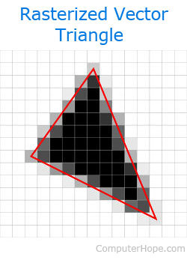


Issues with pipelines 空轉的原因 (all deal with time per stage)
Load balance (across stages) 各級處理一筆資料時間不一樣
one stage takes longer to process each input than the others – becomes a ‘bottleneck’
Example
Rasterizing an ‘average’ triangle in a graphics pipeline takes more time than ‘lighting’ its vertices.
Variable load (across data) 同一級不同資料花的時間不一樣
A given stage takes more time on some inputs than others
Example
The time needed to rasterize a triangle is proportional to the number of fragments in the triangle. The average triangle may contain 20 fragments, but triangles range from 0 to over 1M
Long latency 各級算的時間不一樣
A stage may require a long latency operation (e.g., texture access)
Notes:
都是10ns pipe, 1 級要處理100個，1級處理10個
A資料要花10ns, B資料要花20ns
以頂點為單位的打光
Example: CPU
Cpu + accelerated instructions
Fetch/dec/MUL or add/

Slide 55
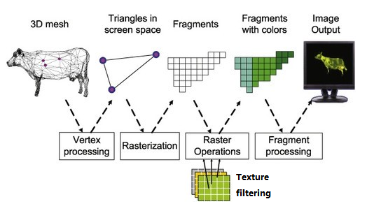
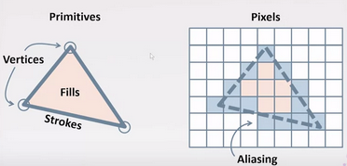
三角形的柵格化方法
Notes:
如何使用OpenGL渲染管道在計算機屏幕上繪製母牛的過程。這也是一個示例，說明可以將任何3D對象區分為微小的三角形，將這些三角形柵格化為像素，然後將不同的顏色填充到這些像素中，最終將它們塑造成屏幕上的對象。

Slide 56
1. Load Balancing Pipelines
Suppose transform takes 2 cycles and clip 4 cycles
Clip is a ‘bottleneck’ pipeline stage
Xform unit is busy only half the time
空轉

Slide 57
Load Balancing Solutions 解法:慢的要加快 1 – Parallel copies of slow unit
Both Distribute and Join modules are required to make
this parallel processing structure work.
平行兩套，相當於
每2個cycle就可以處理一筆新資料
符合Xform輸出速度

Slide 58
Load Balancing Solutions解法:慢的要加快 2 – Split slow pipeline stage
If timing bottleneck modules can be divided evenly,
fully pipelining can be achieved without any stall.
要讓Clip(4cycle)速度與Xform(2cycle)一樣，
就把Clip分成兩級pipeline，相當於
每級也是2個cycle就可以處理一筆新資料
符合Xform輸出速度

Slide 59
When is it better? to split? Or to copy? Throughput and latency are the same
Less area but long latency
More area but less latency
Notes:
Explain why

Slide 60
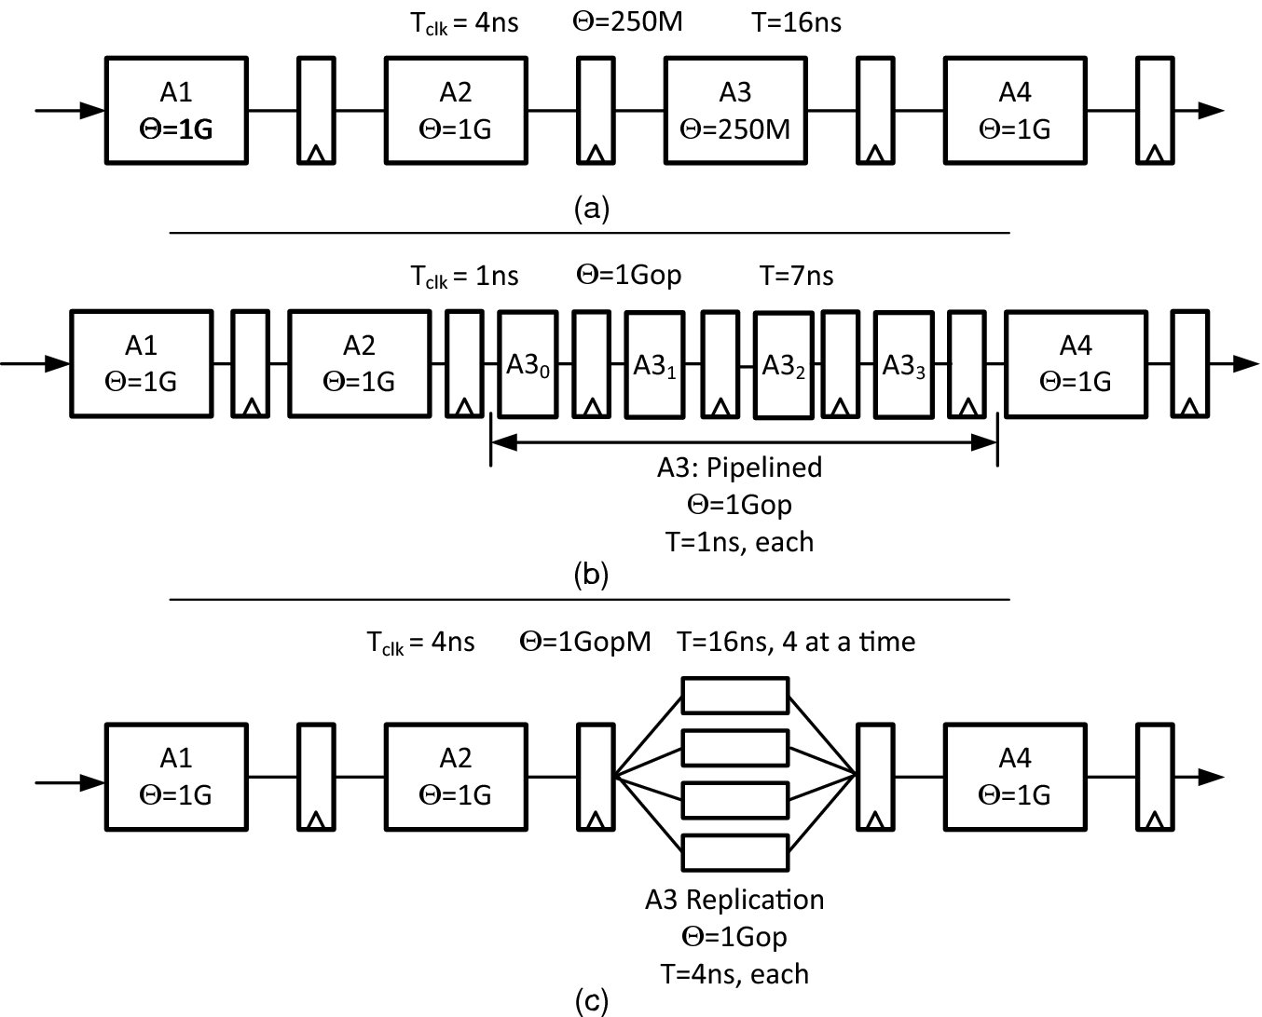

Load Balancing
A3 limits throughput
Pipeline A3 into four 1ns stages for balancing
Parallel A3 four times

Slide 61
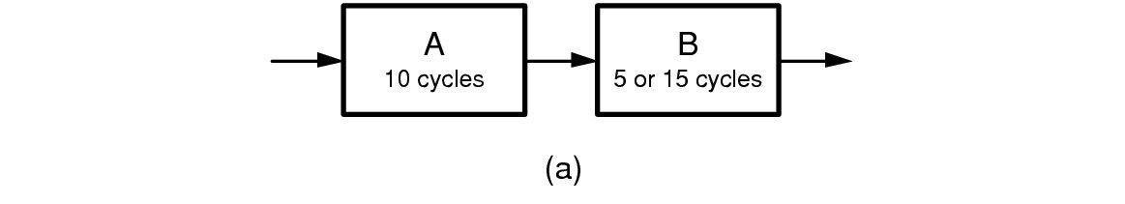

2. Variable load 解法: FIFO or double buffer
Stage A always takes 10 cycles. Stage B takes 5 or 15 cycles – averages 10 cycles Pipeline averages ____ cycles per element
(b) Only a single register sits btw A and B, caused A or B to stall when one is not ready
AB間放一個pipeline register
A 或B還沒算完，就要等
不等待作法: AB間放 FIFO
(變形: double buffer)
不管B有沒有算完，A都繼續
算新資料，A算完的就先存在
FIFO，B直接從FIFO拿資料算
(c) With FIFO to eliminates stalls
Notes:
如何決定FIFO長度?
講解 double buffer

Slide 62
Elastic Pipelines A FIFO between stages decouples timing Allows stages to operate at their ‘average’ speed

Slide 63
3. Stalling a rigid pipeline A stall in any stage halts all stages upstream of the stall point instantly (on the next clock)
如何停pipeline?
部分停 (被停以上的級都要一起停
或是一級一級停)
部分停
Q. What if we stopped all stages, not just upstream stages? 全部停?上游停?
Q. How does the delay of this structure scale with the number of stages?上面停止電路的問題?
Notes:
正常狀況 : 不用 valid ready
要 stall: valid ready control
Stall 的含意: 資料停等在DFF 或FIFO，等下一次可以計算的時間

Slide 64
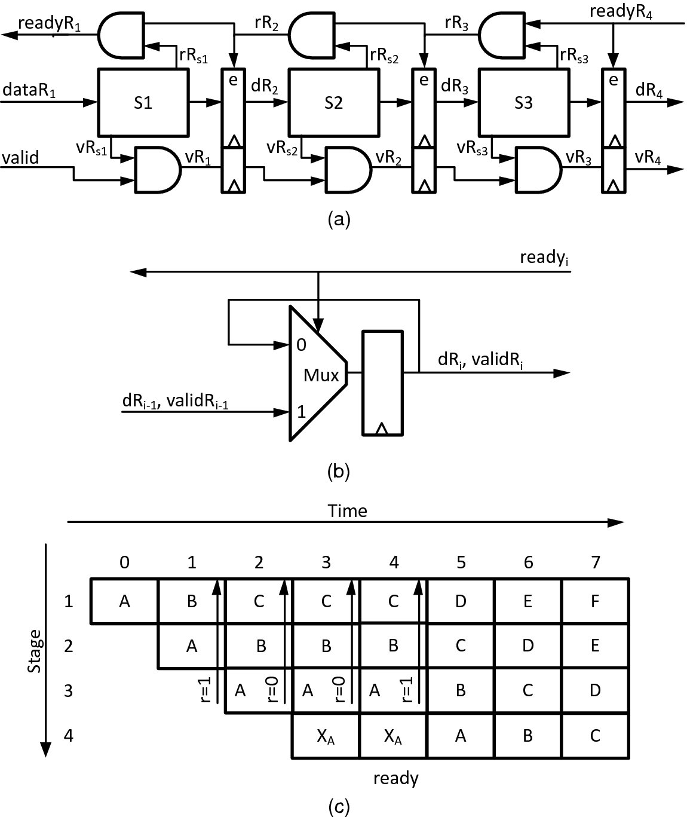
Pipeline with Global Stall Signals
Stall 訊號一次傳給所有上游stage
Pipeline with stall signals
(注意critical path)
Stall logic
(注意如何暫存值，如何正常運行)
Sample execution
使pipeline register 輸入不改變，維持pipeline 的計算值
Notes:
使pipeline register 輸入不改變，維持pipeline 的計算值

Slide 65
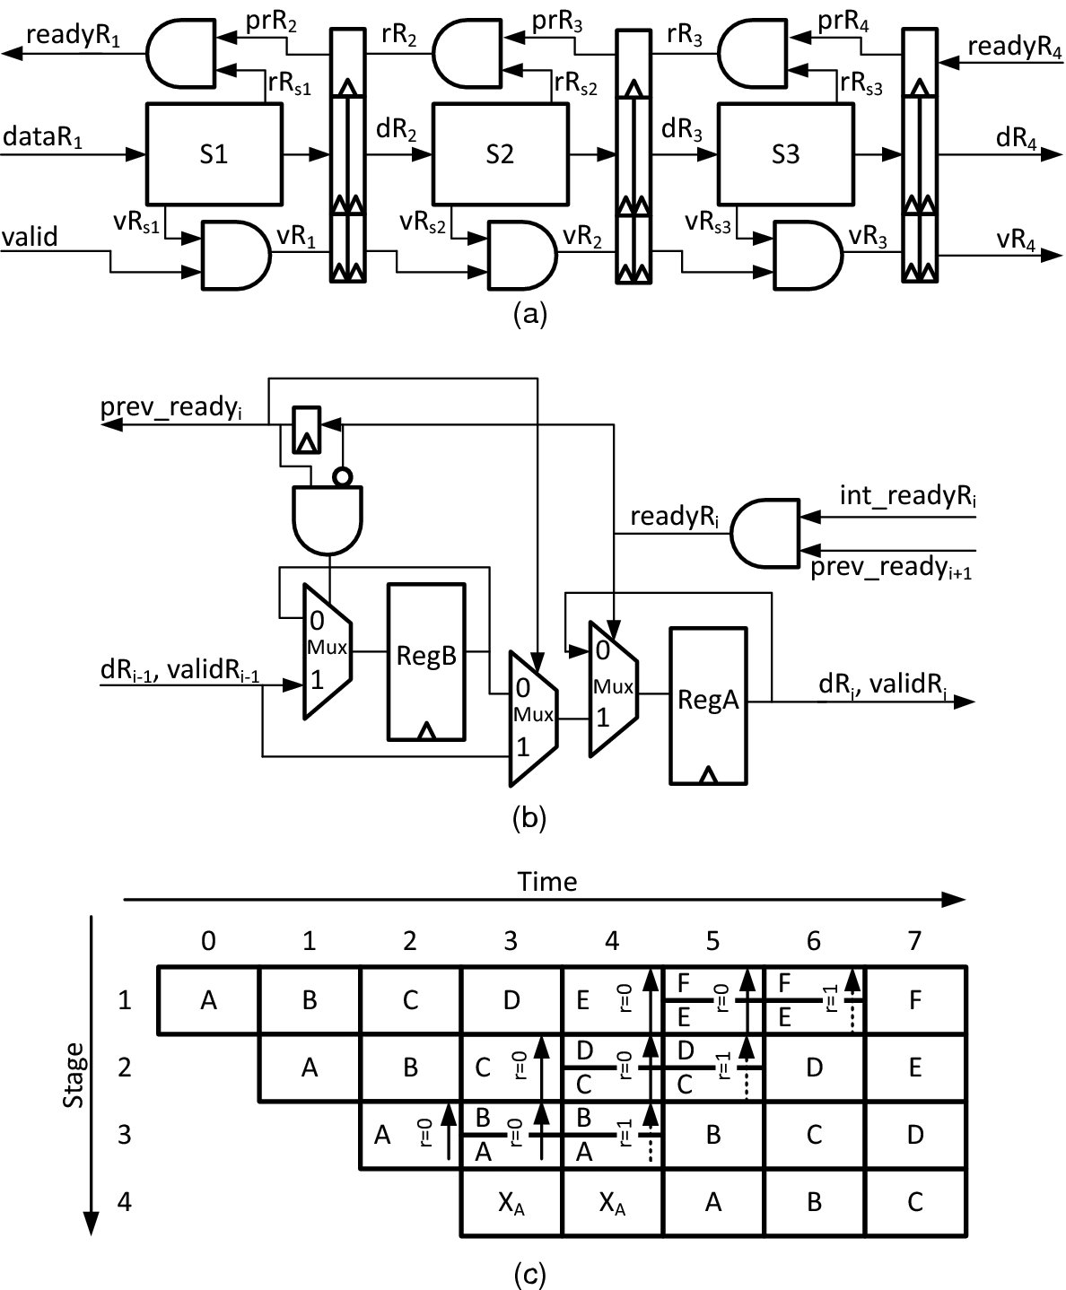
Pipeline with Local Stall Signals (Double Buffering 兩套Registers)
Stall 訊號一級一級往上游傳回去
Clock the ready signals into a DFF at every stage and propagate it upstream one cycle at a time
To avoid losing, need double buffer: one for old data and one for new data arriving
(注意critical path)
When stage i not ready, it sets internal ready to 0, stall old data (stage i-1 has not received “not ready”). Also force another mux control to 0, stall new input data
new
old
把原來這級的pipeline register 輸入先暫存，
前面一級新產生的資料也要暫存
部分停，慢慢停，有些還在算
Notes:
Double buffering avoid long critical path for global stall
Stall 訊號一級一級往上游傳回去

Slide 66
Double Buffer 另一作法
Add an extra buffer to each stage that is filled during the first cycle of a stall.
原來的pipeline registers
輸入在stall的第一個cycle
就先存起來
Extra logics need to be added into each pipelined module.
Buffer size depends on the stall # allowed in specs.

Slide 67
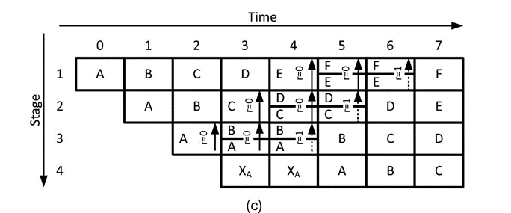
Double Buffer Timing
Stall (not ready)
部分停，慢慢停，有些還在算
Ready
慢慢一級一級放開
Quiz: when Not ready is activated,
All modules need to buffer inputs till
Ready appears. How to reach this goal?
Notes:
Note. We have the ready signal after cycle 3

Slide 68
4. Resource Sharing
Suppose two pipeline stages need to access the same memory
Note: P_{A}+P_{B}+P_{C}+P_{D}=1
How would you set the priority on the arbiter?
優先給下游stage，要被停的stage 會比較少，也避免deadlock
若給上游stage,下游沒資料，也是要停，會造成大量停，而下游要不到資料，無法解除stall，會造成pipeline無法進行下去
Notes:
Grant permission to downstream stages will cause fewer stages to stall than granting an upstream stage and avoid deadlock issues
優先給下游stage，要被停的stage 會比較少，也避免deadlock
若給上游stage,下游沒資料，也是要停，會造成全面停，而下游要不到資料，無法解除stall，會造成pipeline無法進行下去

Slide 69
Pipeline Summary
Divide large problem into stages assembly-line style
Divide evenly or load imbalance will occur
Fix by splitting or copying bottleneck stage
Rigid pipelines have no extra storage between stages
A stall on any stage halts all upstream stages
Hard to stop 100 stages at once
Make this scalable with double-buffering
Variable load results in stalls and idle cycles on a rigid pipeline
Make pipeline elastic by adding FIFOs between key stages
*also related to low-power design by scaling down
Supply voltage.

Slide 70
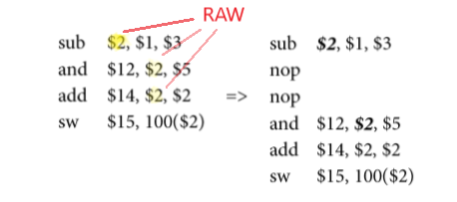
Pipeline Hazard (Optional)
More at computer organization
RAW … (Read after Write)
Notes:
https://king0980692.medium.com/computer-architecture-cheat-sheet-pipeline-hazard-ee27d0d66e89

